Slide 1

Gudeng Precision Industrial Co. Ltd
家登精密工業股份有限公司
2022.07.28
Chairman and CEO
Bill Chiu
Spokesman：Amy Shen
Tel：(02)2268-9141
Mail：AmyShen@gudeng.com

Slide 2
Disclaimer
This document may contain statements about future prospects, which are based on expectations of the current situation, but are subject to known or unknown uncertainties. Hence, actual results may differ from those expressed. Please be aware that all information provided above is for reference only , and please refer to the Market Observation Post System for actual information.
In addition, the company is not obliged to actively update the statement of future outlook in response to the new information or the occurrence of future events.

Slide 3



Gudeng Introduction
Headquarter
Fuxing Factory
Established：1998.3.20
Employee Number： 815
Capital：NT 840,972,700
2020 Revenue：NT 2.5 billion
2021 Revenue：NT 3.12 billion
Main Business：
  Semiconductor
    Mask Handling Solutions
    Wafer Handling Solutions
    Semiconductor Equipment
    Other Service
    Aerospace
Zhongli
Zhubei
Taipei
Gudeng Equipment
We Solutions
Shanghai
Gudeng Shanghai
Tainan
Tree Valley Factory

Slide 4

Customer
Samsung
SK Hynix
Key foundry
Toppan
HOYA
PKL
Nepco
FST
LMTEC
Customer
Gudeng U.S. Office
AMTC、ST Micro Photronics、Toppan Compugraphics、JD Photo Data
SONY
CANON
KIOXIA
UMC12M
HOYA
EPSON
DNP
AGC
ROHM
Gudeng U.S. Office
2020.02
SMIC、Uscxm 、 tsmc Silan、SPIL、Cxmt、Sien CanSemi 、SK Hynix Rongsemi
IBM、tsmc AZ
Micron、WaferTech、Samsung Photronics、Toppan
FormFactor
tsmc、UMC
TMC、PDMC、TCE
VIS、ASE 、 SPIL、Micro
Powerchip、Winbond
GLOBALFOUNDRIES
SSMC 、UMC12i
Micron 、 Silterra、AUO
X FAB、Vanguard 、 Osram
Notes:
請標示各地區的關鍵客戶
4

Slide 5
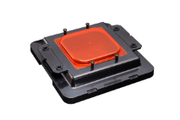
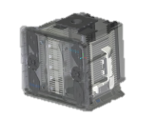
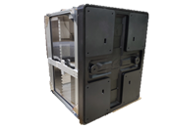
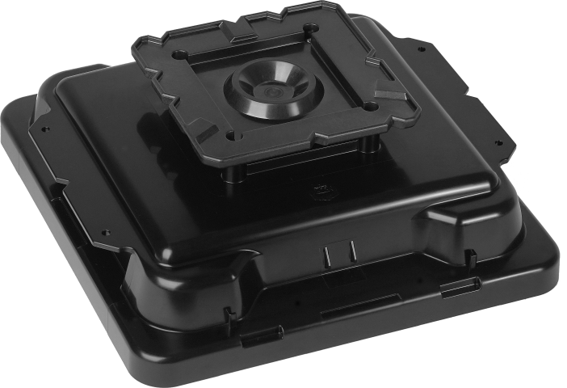
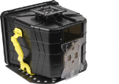
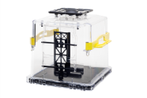

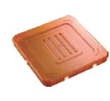


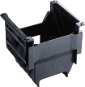
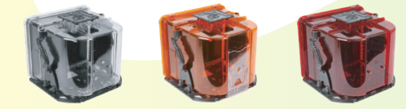
Gudeng Total Solutions
Gudeng Key Wafer Carriers
Process：12”FOUP
Shipping：FOSB
Packaging：510 FOUP
Semiconductor Mature to Advanced Process
Semiconductor Production Process
Product Design
Front End
Back End
Board Assembly
Communication
Automotive
Consumer Electronics
National Defense
PC/NB
IC Design
Mask
Maker
Foundry
Wafer
Sort
Assembly
Final
Test
Board
Assembly
Board
Testing
Circuit Design
Engineering Test
Materials Fab
Wafer Bank
Wafer Bumping
Wafer Probing
Module, Board
Assembly & Test

Slide 6
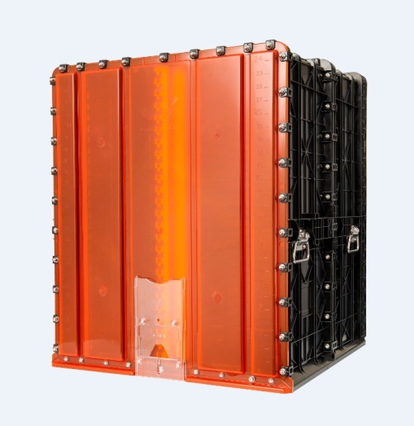
3D Advanced Packaging 510 FOUP
To continue the validity of Moore's Law, 3D advanced packaging technology has begun to enter a stage of rapid growth.
2021 3D packaging capital expenditure reach 11.9 billion US dollars, with a high growth rate in the next three years.
Gudeng is the first to develop 510 FOUP, with market leadership and pricing power.
High-efficiency protection for PCB during transportation
With air tightness and purging function, which can maintain low humidity in the FOUP, effectively reducing the risk of PCB contamination
Compatible with AGV automatic transmission
Meets requirements of dissipative materials

Slide 7
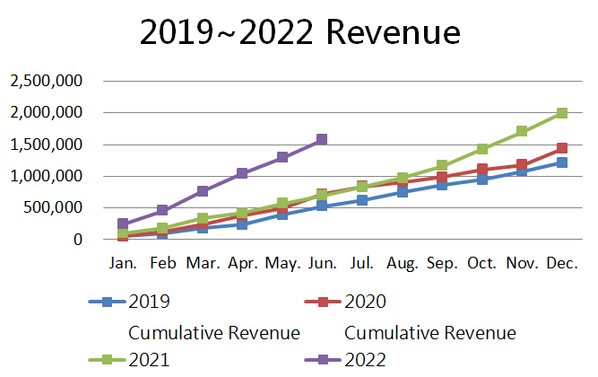
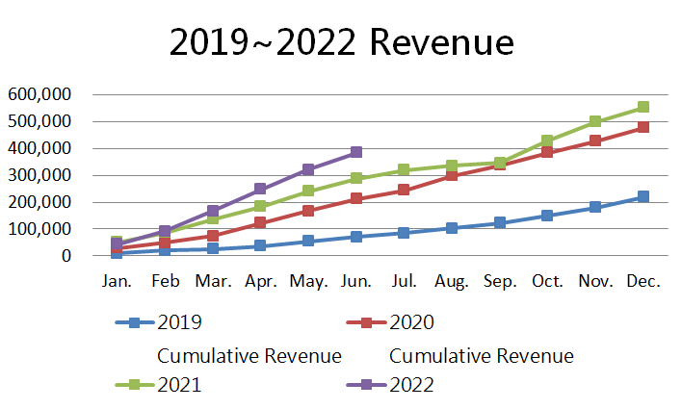
2019 ~2022 Gudeng Revenue
Mask / Wafer
Handling Solutions
Gudeng Equipment
Thousand Dollars

Slide 8
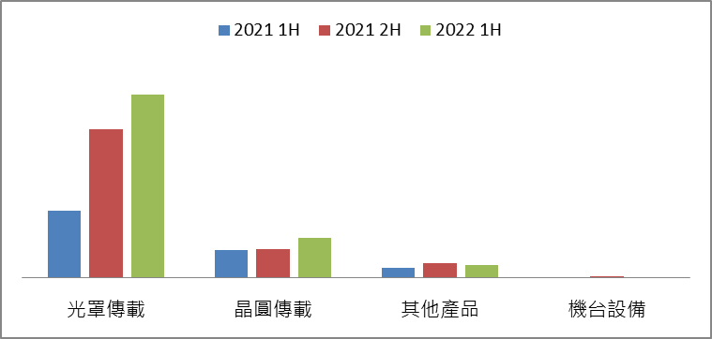
Gudeng Revenue Performance
Mask
Handling
Wafer
Handling
Others
Equipment
○ Mask Handling： EUV POD/ RSP POD/ Reticle Boxes
○ Wafer Handling：front end & back end FOUP/ 8” Wafer Boxes /Cassette

Slide 9
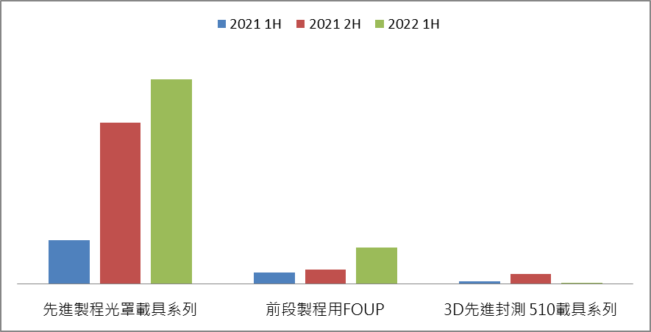
Gudeng Revenue Performance
Gudeng 2022 First Half Main Products Revenue：
Advanced Reticle Carriers $ 890,417,967
RSP Pods $ 259,517,343
FOUPs $ 237,822,585
Advanced
Reticle Carriers
Front End
FOUPs
3D Packaging
510 FOUP

Slide 10
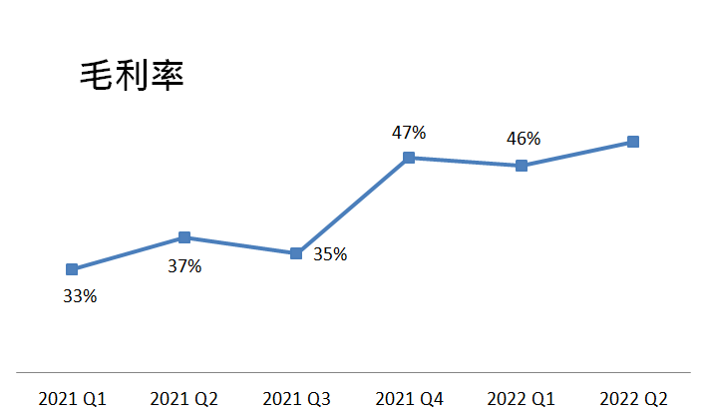
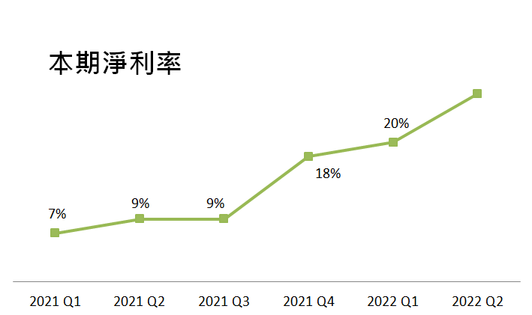
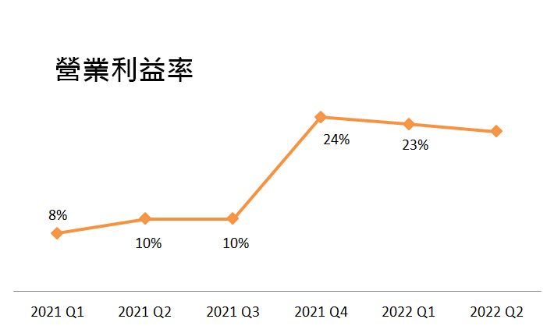
Financial Performance
Growth Trends
Gross Profit Margin
Net Interest Rate
for the current period
Operating Profit Margin
2022/7/28
Copyright© Gudeng Precision Industrial Co. Ltd
10

Slide 11
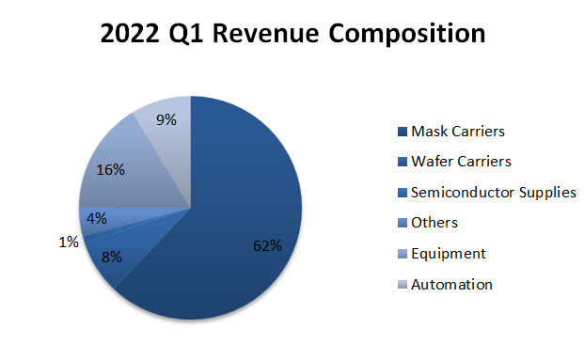
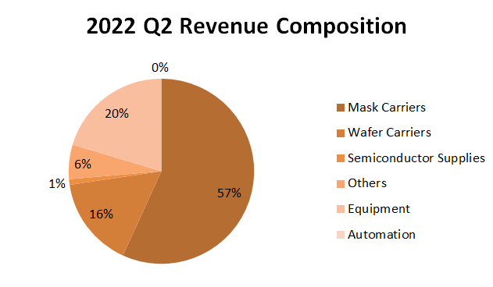
2022 Gudeng Revenue Composition

Slide 12
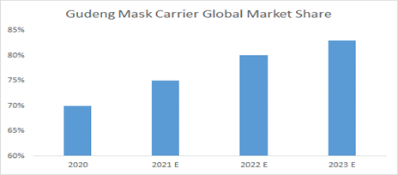
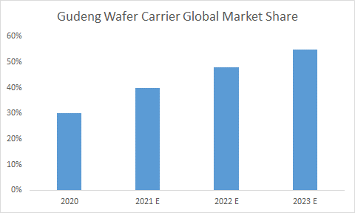
Strategy and Outlook
Strong demand driven by the growth of EUV technology will continue to strengthen in the second half of 2022.
Provide customer integrated solutions, one-stop service for carrier + equipment + system.
Market share of wafer carriers has expanded rapidly, spread all over the world.
Continue to deploy production bases to prepare enough capacity for 2023.
2022/7/28
Copyright© Gudeng Precision Industrial Co. Ltd
12

